Slide 1

Student DRUG TESTING
DER & DATCS Responsibilities
Notes:
QUALITY AND ACCURACY

Slide 2
DER Responsibilities
A Designated Employer Representative (DER) is a school-appointed employee who is authorized to manage and oversee all aspects of the student drug testing process. The DER plays a critical role in ensuring compliance, confidentiality, and coordination between the school and the testing provider.
Key Responsibilities include:
Making decisions who will be tested, approving type of test and handling refusals or non-compliance issues.
Primary point of contact and receives confidential test results and other communications for the school.
Providing updated student lists for testing.
Monitoring the collection process to provide support for DATCS staff and maintain order & discipline.

Slide 3
DATCS STANDARDS FOR school TESTING
School representatives must be present to monitor the process
No “observed” collection will be conducted on minors.
DERs may give the students water at their discretion.
DATCS will offer water after an attempt is made in a urine drug test screening.
Students drinking water will be monitored during the process. Water intake will be limited to 40 ounces.
Verbal results will be given to DERs ONLY and the same day if instant screening tests were performed.
Instant or lab test results will be reported as soon as possible (24-48 hrs) .
ONLY ONE STUDENT AT A TIME WILL BE TESTED. This preserves the integrity of the process, deters cheating, and prevents errors from being made.

Slide 4
School Drug testing Objectives
1. Promote a Safe and Drug-Free Learning Environment
2. Deter Drug Use Among Students
3. Identify Students Who May Need Help
4. Support Legal and Policy Compliance
5. Reinforce School and Community Values
6. Protect the Health and Well-Being of Students
7. Provide Documentation for Legal or Disciplinary Actions
8. Educate Students and Families

Slide 5
Student privacy DURING DRUG TESTING
Maintaining student privacy is a critical component of any school drug testing program. It ensures dignity, reduces anxiety, and builds trust in the process. The following guidelines should be followed to protect student privacy throughout the testing procedure:
Use designated testing areas that ensure privacy from other students and passersby
Avoid high-traffic locations such as hallway bathrooms, bathrooms near entrances, and stage-area bathrooms
Ensure female students receive additional privacy considerations during testing
Limit access to the testing area to authorized personnel only
Maintain a quiet, respectful environment to reduce stress and embarrassment
Clearly explain the testing process to students to promote understanding and comfort
Secure all documentation and results to protect student confidentiality

Slide 6
School drug testing procedures
Physical Layout & Equipment
Tables & Trash Cans
  Set up tables near the bathroom entrance for paperwork, supplies, and collector use. Do not test in a busy hallway.
  Place trash cans outside the testing area only—remove all trash cans from inside the bathroom to prevent concealment or tampering.
DER Monitoring Station
  Position a chair near the bathroom entrance for the Designated Employer Representative (DER) to monitor student entry and exit.
  Ensure the DER has a clear view of the testing area but maintains student privacy.
  To ensure student’s privacy and not a “monitored” collection, DATCS staff must not be able to view the student’s feet under the stall or at a urinal.
Safety & Cleanliness
  Remove any cleaning supplies, or other chemicals from the bathroom. Tape over hygiene product dispensers.

Slide 7
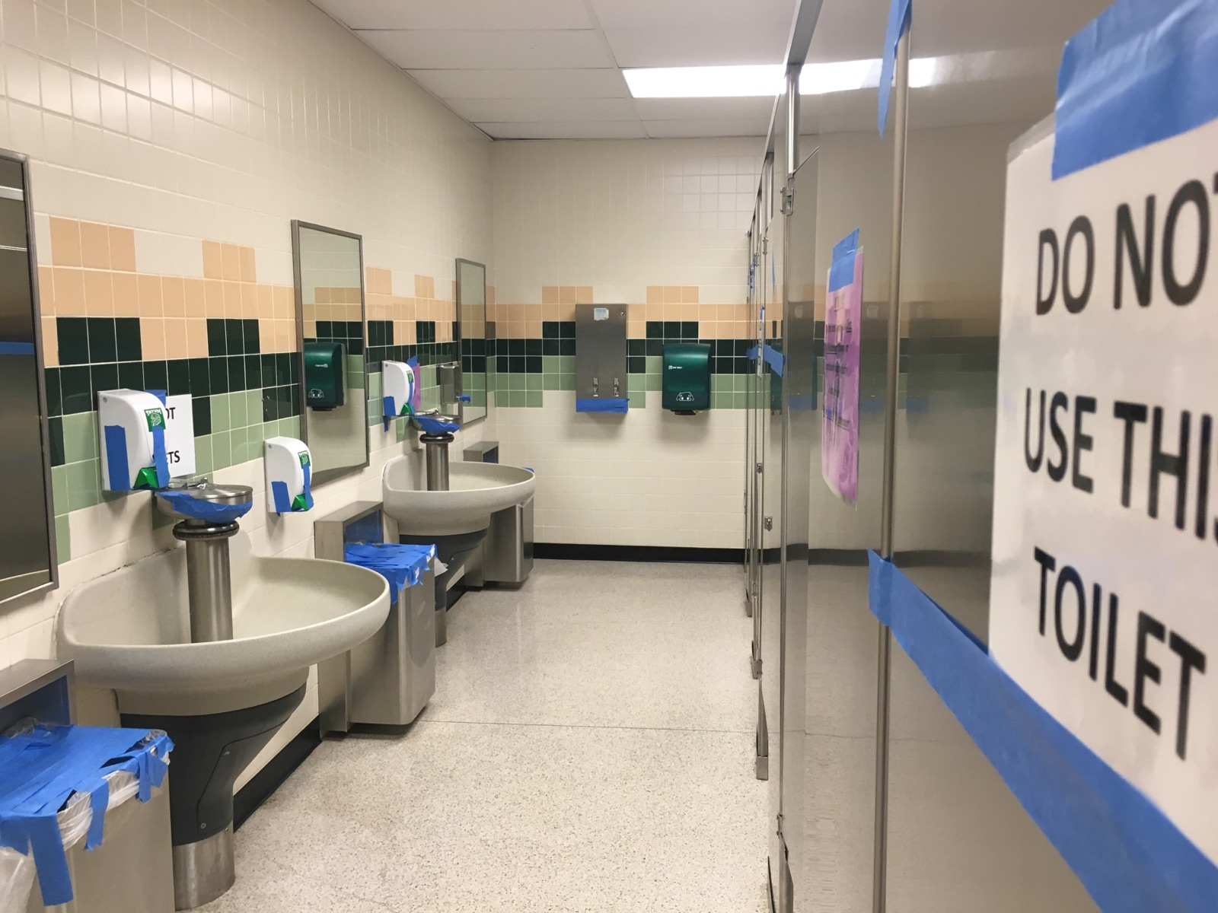
School drug testing procedures
Securing Water Sources
Faucets & Toilets
  Tape over all sink faucets to prevent tampering.
  Tape toilet handles, urinals or tape over toilet sensor to prevent flushing during the test. (use several layers of tape over the toilet sensor)
  Add bluing tablet to each toilet bowl to detect dilution attempts.
Soap Dispensers
  Tape up all soap dispensers to prevent use during testing.
Bathroom Access Control
  Signage place clear “Testing in Progress – Do Not Enter” signs at all entrances.
Stall & Urinal Management
  Tape closed any stall doors or urinals that are not designated for use.
  Ensure only one stall or one urinal is available for testing, if applicable.

Slide 8

School drug testing procedures
Preferred Student Identification
  Identify the student by a school official or photo identification.
  Student identification should include first name, last name, and an identification number.
  A lunch number can be used as the student ID.

Slide 9
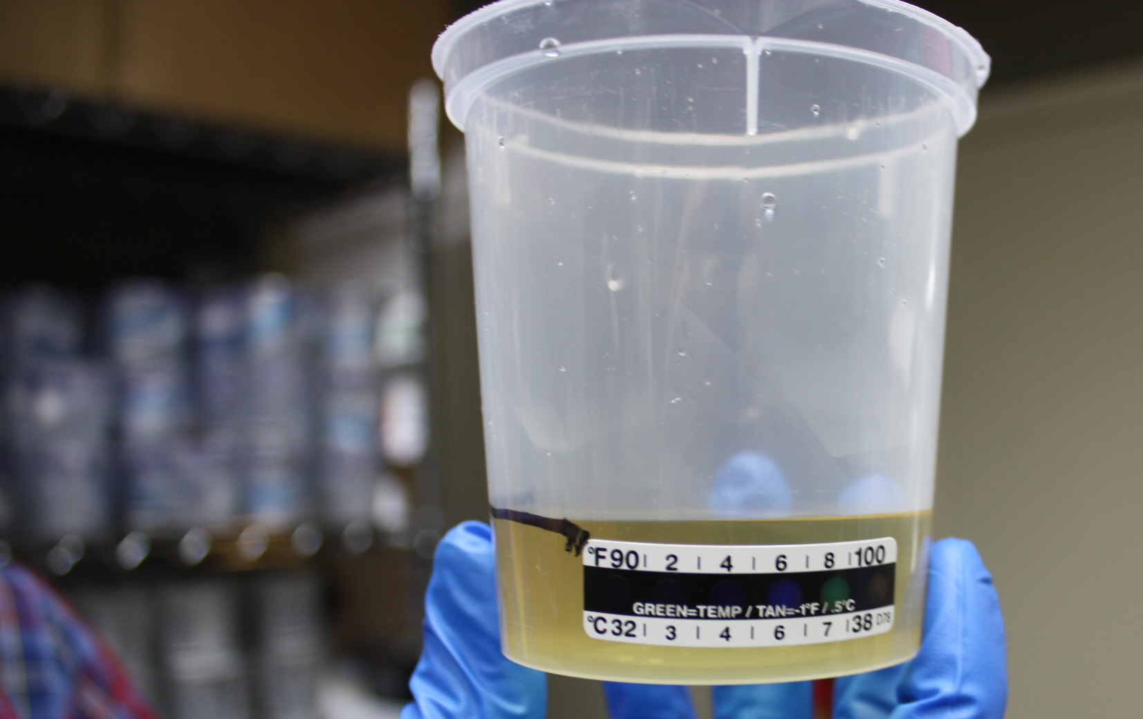
School drug testing procedures
Instruct the student to do the following
  Empty pockets and remove all outerwear such as jackets and coats and hats.
  Do not use the faucets or soap dispensers.
  Wipe hands with a hand wipe that we provide.
  Please use the stall indicated.
  Fill the collection cup to the line marked (45 ml).
  Do not flush the toilet.
  The test is time sensitive for the temperature reading; the collector will knock on the door if the time is running out (4 minutes).
  Only test 1 student at a time.

Slide 10
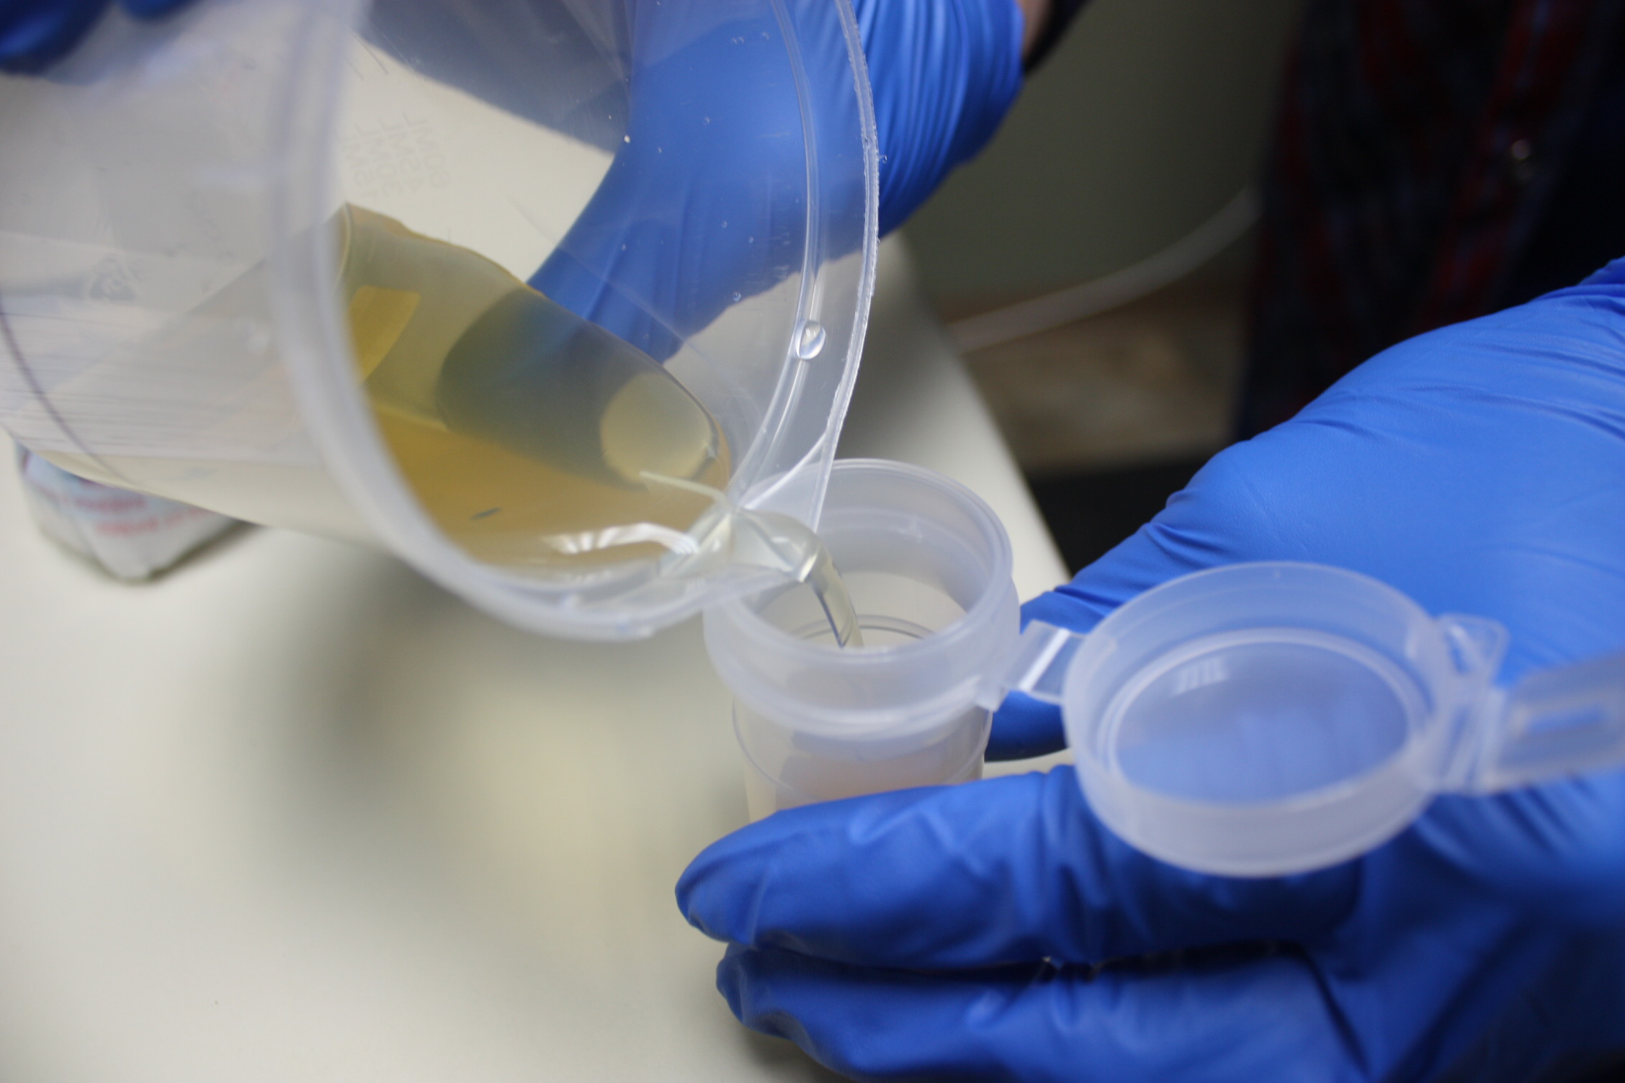
School drug testing procedures
Collection Process
The DER will stand close by to monitor time and sounds.
When the donor exits the bathroom, the collector checks the temperature on the specimen cup to verify the specimen was between 90-100 degrees.
The collector examines the specimen for abnormal conditions such as excessive foaming, foreign objects in the specimen such as bluing or a chemical smell.
The collector pours 30 ml of the specimen into a vial.
Place the screening test device in the remaining specimen.
Fill out the test form and direct the student to sign the form. We do not need the students phone number on the CCF.
Read the device and discreetly mark the result out of view.
The student should remain present until testing is complete to preserve the integrity of the process.
Students do not get a copy of the POCT or lab copy. All documentation will be given to the DER.

Slide 11

Confidentially & Scheduling Random Drug testing
Keep random testing confidential until the day of testing.
Vary testing dates and times to prevent predictability and deter cheating.
Avoid setting testing on the same day or time each month.
Ensure staff involved in testing maintain strict confidentiality.
Recommended: Schools should have a written drug testing policy.
DATCS can provide a sample School Drug Testing Policy upon request.

Slide 12

DRUG TEST REFUSALS
AND NO TEMPERATURE
If a student refuses to follow protocol or walks away from testing after it has been initiated, it is considered a refusal which equates to a positive and should be treated as such.
A specimen that is not within the temperature of 90-100 degrees indicates that the urine did not come from the donor’s body. If this occurs, we recommended:
Switch to an oral fluid collection.
Notify the parents to bring the student to our clinic for an observed collection. The parent will be advised on how to observe their child in the drug testing process.
Our staff will not observe a minor’s urine drug test.

Slide 13

SHY BLADDER protocol
SHY BLADDER is defined as a student who is unable to provide a urine specimen or unable to provide a sufficient quantity required for testing.
SHY BLADDER PROTOCOL
  An attempt must be made to provide a sample.
  The student is then provided 40 ounces of water.
  Students are then monitored in a designated area.
  It is recommended that the student have up to 3 hours to provide a sample.
In the event a student is unable to provide a urine sample, schools can opt to use oral fluid (saliva) drug testing. By adding oral fluid testing to your student drug testing policy, it will allow students to get back to class sooner.

Slide 14

Oral fluid (saliva)
Oral Fluid Collections
Oral fluid is the best method for detecting current impairment. The window of detection is within minutes up to 2 to 3 days. This shorter detection period, especially for marijuana, identifies recent drug use. Oral fluid testing:
  Eliminates shy bladder delays and students get back to class sooner.
  Difficult to cheat.
  Quick & easy to test.
ALL NON-NEG RESULTS MUST BE CONFIRMED by a lab oral fluid test. This ensures testing within the same detection window.

Slide 15
Drug & alcohol awareness training for students
We offer drug and alcohol awareness training for students and educators. The training includes the short and long-term effects of each substance and how to recognize substance abuse.
Our Vision
We see comprehensive prevention, detection, and early intervention programs having a massive impact on reducing substance abuse and improving the safety and wellbeing of families, businesses, and schools.
Our Mission
We are on a mission to educate our clients and community about accurate and appropriate drug & alcohol testing.
We are committed to administering programs that improve safety and increase the odds that our children will grow up free from harm.
Our Promise
We improve work and school environments through testing and screening that promotes safety, compliance, and wellbeing. We provide timely, accurate, affordable testing and expert training to help our clients understand and make smart decisions about the results.

